Slide 1

Chapter 13 – Data Warehousing

Slide 2
Databases
Databases are developed on the IDEA that DATA is one of the critical materials of the Information Age
Information, which is created by data, becomes the bases for decision making

Slide 3
Decision Support Systems
Created to facilitate the decision making process
So much information that it is difficult to extract it all from a traditional database
Need for a more comprehensive data storage facility
  Data Warehouse

Slide 4
Decision Support Systems
Extract Information from data to use as the basis for decision making
Used at all levels of the Organization
Tailored to specific business areas
Interactive
Ad Hoc queries to retrieve and display information
Combines historical operation data with business activities

Slide 5
4 Components of DSS
Data Store – The DSS Database
  Business Data
  Business Model Data
  Internal and External Data
Data Extraction and Filtering
  Extract and validate data from the operational database and the external data sources

Slide 6
4 Components of DSS
End-User Query Tool
  Create Queries that access either the Operational or the DSS database
End User Presentation Tools
  Organize and Present the Data

Slide 7
Differences with DSS
Operational
  Stored in Normalized Relational Database
  Support transactions that represent daily operations (Not Query Friendly)
3 Main Differences
  Time Span
  Granularity
  Dimensionality

Slide 8
Time Span
Operational
  Real Time
  Current Transactions
  Short Time Frame
  Specific Data Facts
DSS
  Historic
  Long Time Frame (Months/Quarters/Years)
  Patterns

Slide 9
Granularity
Operational
  Specific Transactions that occur at a given time
DSS
  Shown at different levels of aggregation
  Different Summary Levels
  Decompose (drill down)
  Summarize (roll up)

Slide 10
Dimensionality
Most distinguishing characteristic of DSS data
Operational
  Represents atomic transactions
DSS
  Data is related in Many ways
  Develop the larger picture
  Multi-dimensional view of data

Slide 11
DSS Database Requirements
DSS Database Scheme
  Support Complex and Non-Normalized data
    Summarized and Aggregate data
    Multiple Relationships
    Queries must extract multi-dimensional time slices
    Redundant Data

Slide 12
DSS Database Requirements
Data Extraction and Filtering
  DSS databases are created mainly by extracting data from operational databases combined with data imported from external source
    Need for advanced data extraction & filtering tools
    Allow batch / scheduled data extraction
    Support different types of data sources
    Check for inconsistent data / data validation rules
    Support advanced data integration / data formatting conflicts

Slide 13
DSS Database Requirements
End User Analytical Interface
  Must support advanced data modeling and data presentation tools
  Data analysis tools
  Query generation
  Must Allow the User to Navigate through the DSS
Size Requirements
  VERY Large – Terabytes
  Advanced Hardware (Multiple processors, multiple disk arrays, etc.)

Slide 14
Data Warehouse
DSS – friendly data repository for the DSS is the DATA WAREHOUSE
Definition: Integrated, Subject-Oriented, Time-Variant, Nonvolatile database that provides support for decision making

Slide 15
Integrated
The data warehouse is a centralized, consolidated database that integrated data derived from the entire organization
  Multiple Sources
  Diverse Sources
  Diverse Formats

Slide 16
Subject-Oriented
Data is arranged and optimized to provide answer to questions from diverse functional areas
  Data is organized and summarized by topic
    Sales / Marketing / Finance / Distribution / Etc.

Slide 17
Time-Variant
The Data Warehouse represents the flow of data through time
Can contain projected data from statistical models
Data is periodically uploaded then time-dependent data is recomputed

Slide 18
Nonvolatile
Once data is entered it is NEVER removed
Represents the company’s entire history
  Near term history is continually added to it
  Always growing
  Must support terabyte databases and multiprocessors
Read-Only database for data analysis and query processing

Slide 19
Data Marts
Small Data Stores
More manageable data sets
Targeted to meet the needs of small groups within the organization
Small, Single-Subject data warehouse subset that provides decision support to a small group of people

Slide 20
OLAP
Online Analytical Processing Tools
DSS tools that use multidimensional data analysis techniques
  Support for a DSS data store
  Data extraction and integration filter
  Specialized presentation interface

Slide 21
12 Rules of a Data Warehouse
Data Warehouse and Operational Environments are Separated
Data is integrated
Contains historical data over a long period of time
Data is a snapshot data captured at a given point in time
Data is subject-oriented

Slide 22
12 Rules of Data Warehouse
Mainly read-only with periodic batch updates
Development Life Cycle has a data driven approach versus the traditional process-driven approach
Data contains several levels of detail
  Current, Old, Lightly Summarized, Highly Summarized

Slide 23
12 Rules of Data Warehouse
Environment is characterized by Read-only transactions to very large data sets
System that traces data sources, transformations, and storage
Metadata is a critical component
  Source, transformation, integration, storage, relationships, history, etc
Contains a chargeback mechanism for resource usage that enforces optimal use of data by end users

Slide 24
OLAP
Need for More Intensive Decision Support
4 Main Characteristics
  Multidimensional data analysis
  Advanced Database Support
  Easy-to-use end-user interfaces
  Support Client/Server architecture

Slide 25
Multidimensional Data Analysis Techniques
Advanced Data Presentation Functions
  3-D graphics, Pivot Tables, Crosstabs, etc.
  Compatible with Spreadsheets & Statistical packages
  Advanced data aggregations, consolidation and classification across time dimensions
  Advanced computational functions
  Advanced data modeling functions

Slide 26
Advanced Database Support
Advanced Data Access Features
  Access to many kinds of DBMS’s, flat files, and internal and external data sources
  Access to aggregated data warehouse data
  Advanced data navigation (drill-downs and roll-ups)
  Ability to map end-user requests to the appropriate data source
  Support for Very Large Databases

Slide 27
Easy-to-Use End-User Interface
Graphical User Interfaces
Much more useful if access is kept simple

Slide 28
Client/Server Architecture
Framework for the new systems to be designed, developed and implemented
Divide the OLAP system into several components that define its architecture
  Same Computer
  Distributed among several computer

Slide 29
OLAP Architecture
3 Main Modules
  GUI
  Analytical Processing Logic
  Data-processing Logic

Slide 30
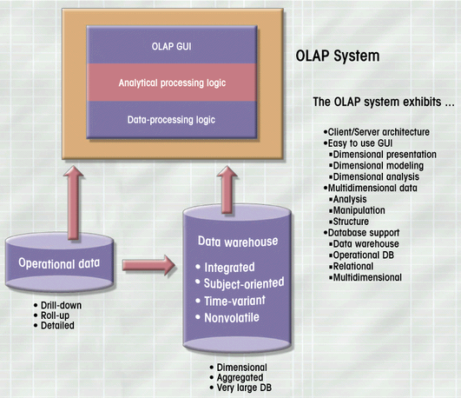
OLAP Client/Server Architecture

Slide 31
Relational OLAP
Relational Online Analytical Processing
  OLAP functionality using relational database and familiar query tools to store and analyze multidimensional data
Multidimensional data schema support
Data access language & query performance for multidimensional data
Support for Very Large Databases

Slide 32
Multidimensional Data Schema Support
Decision Support Data tends to be
  Nonnormalized
  Duplicated
  Preaggregated
Star Schema
  Special Design technique for multidimensional data representations
  Optimize data query operations instead of data update operations

Slide 33
Star Schemas
Data Modeling Technique to map multidimensional decision support data into a relational database
Current Relational modeling techniques do not serve the needs of advanced data requirements

Slide 34
Star Schema
4 Components
  Facts
  Dimensions
  Attributes
  Attribute Hierarchies

Slide 35
Facts
Numeric measurements (values) that represent a specific business aspect or activity
Stored in a fact table at the center of the star scheme
Contains facts that are linked through their dimensions
Can be computed or derived at run time
Updated periodically with data from operational databases

Slide 36
Dimensions
Qualifying characteristics that provide additional perspectives to a given fact
  DSS data is almost always viewed in relation to other data
Dimensions are normally stored in dimension tables

Slide 37
Attributes
Dimension Tables contain Attributes
Attributes are used to search, filter, or classify facts
Dimensions provide descriptive characteristics about the facts through their attributed
Must define common business attributes that will be used to narrow a search, group information, or describe dimensions. (ex.: Time / Location / Product)
No mathematical limit to the number of dimensions (3-D makes it easy to model)

Slide 38
Attribute Hierarchies
Provides a Top-Down data organization
  Aggregation
  Drill-down / Roll-Up data analysis
Attributes from different dimensions can be grouped to form a hierarchy

Slide 39
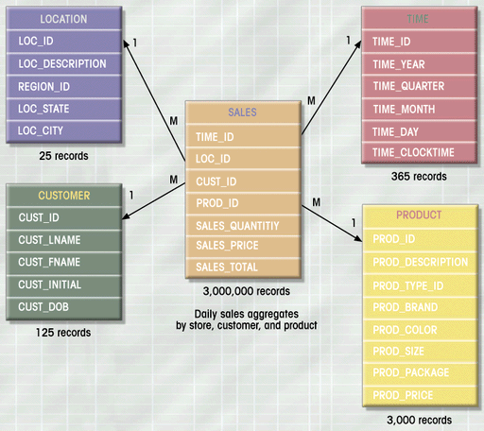
Star Schema for Sales
Dimension Tables
Fact Table

Slide 40
Star Schema Representation
Fact and Dimensions are represented by physical tables in the data warehouse database
Fact tables are related to each dimension table in a Many to One relationship (Primary/Foreign Key Relationships)
Fact Table is related to many dimension tables
  The primary key of the fact table is a composite primary key from the dimension tables
Each fact table is designed to answer a specific DSS question

Slide 41
Star Schema
The fact table is always the larges table in the star schema
Each dimension record is related to thousand of fact records
Star Schema facilitated data retrieval functions
DBMS first searches the Dimension Tables before the larger fact table

Slide 42
Data Warehouse Implementation
An Active Decision Support Framework
  Not a Static Database
  Always a Work in Process
  Complete Infrastructure for Company-Wide decision support
  Hardware / Software / People / Procedures / Data
  Data Warehouse is a critical component of the Modern DSS – But not the Only critical component

Slide 43
Data Mining
Discover Previously unknown data characteristics, relationships, dependencies, or trends
Typical Data Analysis Relies on end users
  Define the Problem
  Select the Data
  Initial the Data Analysis
  Reacts to External Stimulus

Slide 44
Data Mining
Proactive
Automatically searches
  Anomalies
  Possible Relationships
  Identify Problems before the end-user
Data Mining tools analyze the data, uncover problems or opportunities hidden in data relationships, form computer models based on their findings, and then user the models to predict business behavior – with minimal end-user intervention

Slide 45
Data Mining
A methodology designed to perform knowledge-discovery expeditions over the database data with minimal end-user intervention
3 Stages of Data
  Data
  Information
  Knowledge

Slide 46
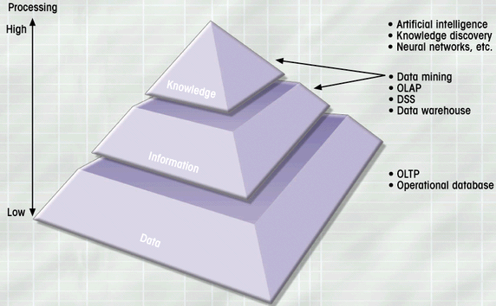
Extraction of Knowledge from Data

Slide 47
4 Phases of Data Mining
Data Preparation
  Identify the main data sets to be used by the data mining operation (usually the data warehouse)
Data Analysis and Classification
  Study the data to identify common data characteristics or patterns
    Data groupings, classifications, clusters, sequences
    Data dependencies, links, or relationships
    Data patterns, trends, deviation

Slide 48
4 Phases of Data Mining
Knowledge Acquisition
  Uses the Results of the Data Analysis and Classification phase
  Data mining tool selects the appropriate modeling or knowledge-acquisition algorithms
    Neural Networks
    Decision Trees
    Rules Induction
    Genetic algorithms
    Memory-Based Reasoning
Prognosis
  Predict Future Behavior
  Forecast Business Outcomes
    65% of customers who did not use a particular credit card in the last 6 months are 88% likely to cancel the account.

Slide 49
Data Mining
Still a New Technique
May find many Unmeaningful Relationships
Good at finding Practical Relationships
  Define Customer Buying Patterns
  Improve Product Development and Acceptance
  Etc.
Potential of becoming the next frontier in database development

